Slide 1
Child Vaccine Notifier System
Submitted By:
Group No: 36
Harish Bhashkar Domale (219060)
Saurabh Bhatu Chavan (219053)
Prashant Karhale Mr. Kashinath Patil
Centre Coordinator Project Guide

Slide 2
Introduction
Kid's Immunization is an application on Child Vaccination in India that help parents keep track of the vaccination needs of their children. A parent will be register the child on the web application of Kid's Immunization and a vaccination calendar gets generated for that child. The child will be registered by the parent and vaccination record will updated at any end gets updated on the registered id of the parents.

Slide 3
This system provides following benefits:
Vaccination records will be digitized making a parent free from keeping manual vaccination records
of the child.
By making this system online, staff requirement is reduced.
Can predict the demand of vaccines requirement easily as we have DOB of every registered child.
Vaccine wastage is minimize.
Parents can easily track the records of vaccines.

Slide 4
Tools And Technologies Used
Server Side:
Spring Tool Suite
Java 11
Spring Boot
Spring Data JPA(Hibernate)
MySQL database
Maven
Jason Web Token
Postman client
Client side:
- Visual Studio Code IDE
React JS
React Hooks
Bootstrap 5
Axios Http library

Slide 5
Modules
Admin
Hospital
User

Slide 6
Admin
After successful login admin is able to view Admin Dashboard, where Admin can find functionality like Hospital in which Admin can register a new hospital, edit hospital details and delete hospital. Similarly admin can add, update and delete Doctor and Vaccine. Admin can see beneficiary and booking details and admin can delete beneficiary and booking also.
Admin
Hospital
Doctor
Vaccine
Beneficiary
Booking Details

Slide 7
Hospital
After successful login hospital is able to view Hospital Dashboard, where hospital can find functionality like, view all bookings where hospital can see all upcoming bookings. Hospital can also see vaccine details and doctor details.
Hospital
View Doctors
View Vaccine
Booking Details

Slide 8
User
After successful login user is able to view User Dashboard, where user can find functionality like book vaccine where user can book vaccine for his child depending on availability, user can also view vaccine information and booking history where as user can also edit profile.
User
View Vaccine
Book Vaccine
Book List
Edit Profile

Slide 9
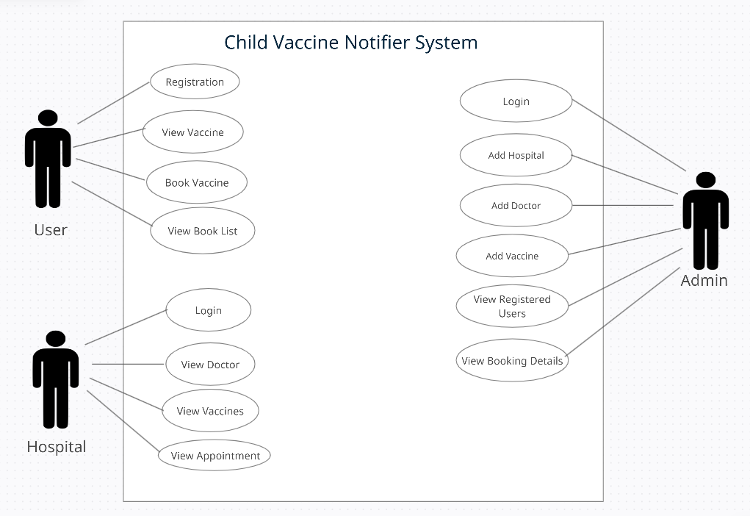
Use Case Diagram

Slide 10
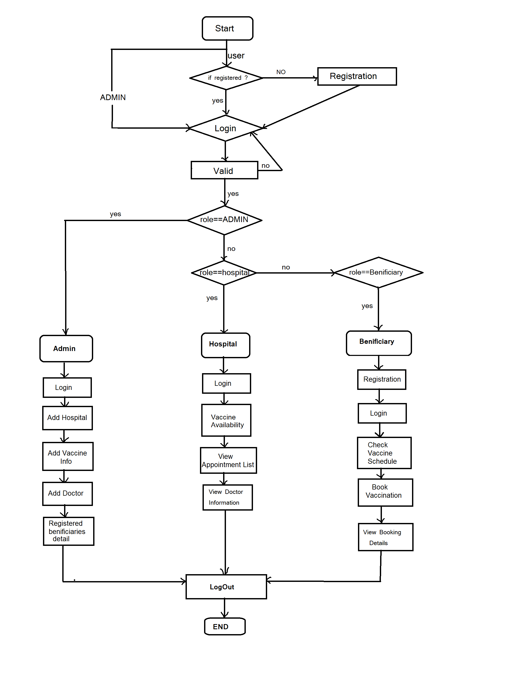
System Flow Diagram

Slide 11
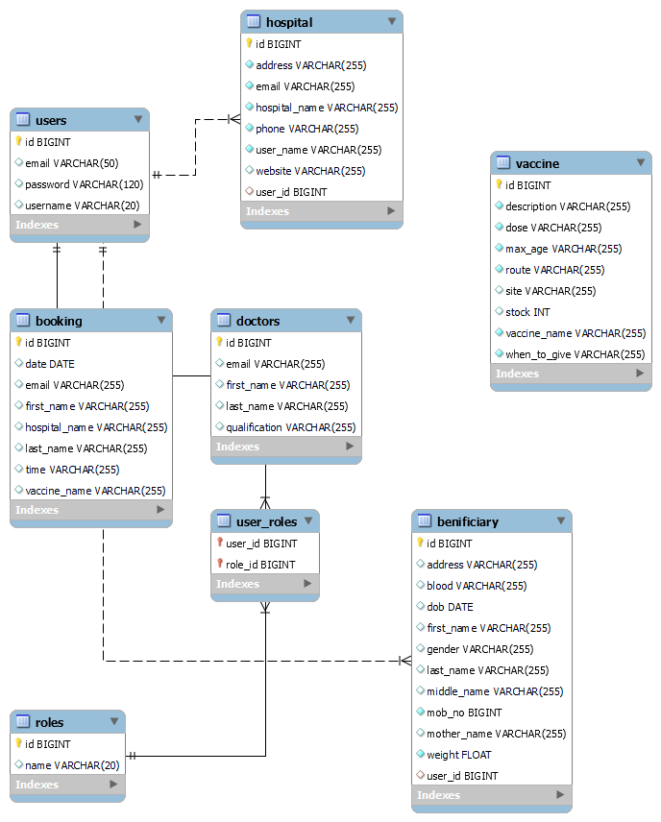
ER Diagram

Slide 12
Roles Table
Field | Type | Null | Key | Default | Extra
id | bigint | NO | PRI | NULL | auto_increment
name | varchar(20) | YES |  | NULL
Users Table
Field | Type | Null | Key | Default | Extra
id | bigint | NO | PRI | NULL | auto_increment
email | varchar(50) | YES | UNI | NULL
password | varchar(120) | YES |  | NULL
username | varchar(20) | YES | UNI | NULL

Slide 13
User_Roles Table
Field | Type | Null | Key | Default | Extra
user_id | bigint | NO | PRI | NULL
role_id | bigint | NO | PRI | NULL
Vaccine Table
Field | Type | Null | Key | Default | Extra
id | bigint | NO | PRI | NULL | auto_increment
description | varchar(255) | NO |  | NULL
dose | varchar(255) | NO |  | NULL
max_age | varchar(255) | NO |  | NULL
route | varchar(255) | NO |  | NULL
site | varchar(255) | YES |  | NULL
stock | int | YES |  | NULL
vaccine_name | varchar(255) | NO |  | NULL
when_to_give | varchar(255) | NO |  | NULL

Slide 14
Benificiary Table
Field | Type | Null | Key | Default | Extra
id | bigint | NO | PRI | NULL | auto_increment
address | varchar(255) | YES |  | NULL
blood | varchar(255) | YES |  | NULL
dob | date | YES |  | NULL
first_name | varchar(255) | YES |  | NULL
last_name | varchar(255) | YES |  | NULL
middle_name | varchar(255) | YES |  | NULL
mob_no | bigint | NO |  | NULL
mother_name | varchar(255) | YES |  | NULL
weight | float | NO |  | NULL
gender | varchar(255) | YES |  | NULL
Hospital Table
Field | Type | Null | Key | Default | Extra
id | bigint | NO | PRI | NULL | auto_increment
address | varchar(255) | NO |  | NULL
email | varchar(255) | NO |  | NULL
hospital_name | varchar(255) | NO |  | NULL
phone | varchar(255) | NO |  | NULL
user_name | varchar(255) | NO |  | NULL
website | varchar(255) | YES |  | NULL
user_id | bigint | YES | MUL | NULL

Slide 15
Doctor Table
Field | Type | Null | Key | Default | Extra
id | bigint | NO | PRI | NULL | auto_increment
email | varchar(255) | YES |  | NULL
first_name | varchar(255) | YES |  | NULL
last_name | varchar(255) | YES |  | NULL
qualification | varchar(255) | YES |  | NULL
Booking Table
Field | Type | Null | Key | Default | Extra
id | bigint | NO | PRI | NULL | auto_increment
date | date | YES |  | NULL
email | varchar(255) | YES |  | NULL
first_name | varchar(255) | YES |  | NULL
hospital_name | varchar(255) | YES |  | NULL
last_name | varchar(255) | YES |  | NULL
time | varchar(255) | YES |  | NULL
vaccine_name | varchar(255) | YES |  | NULL

Slide 16
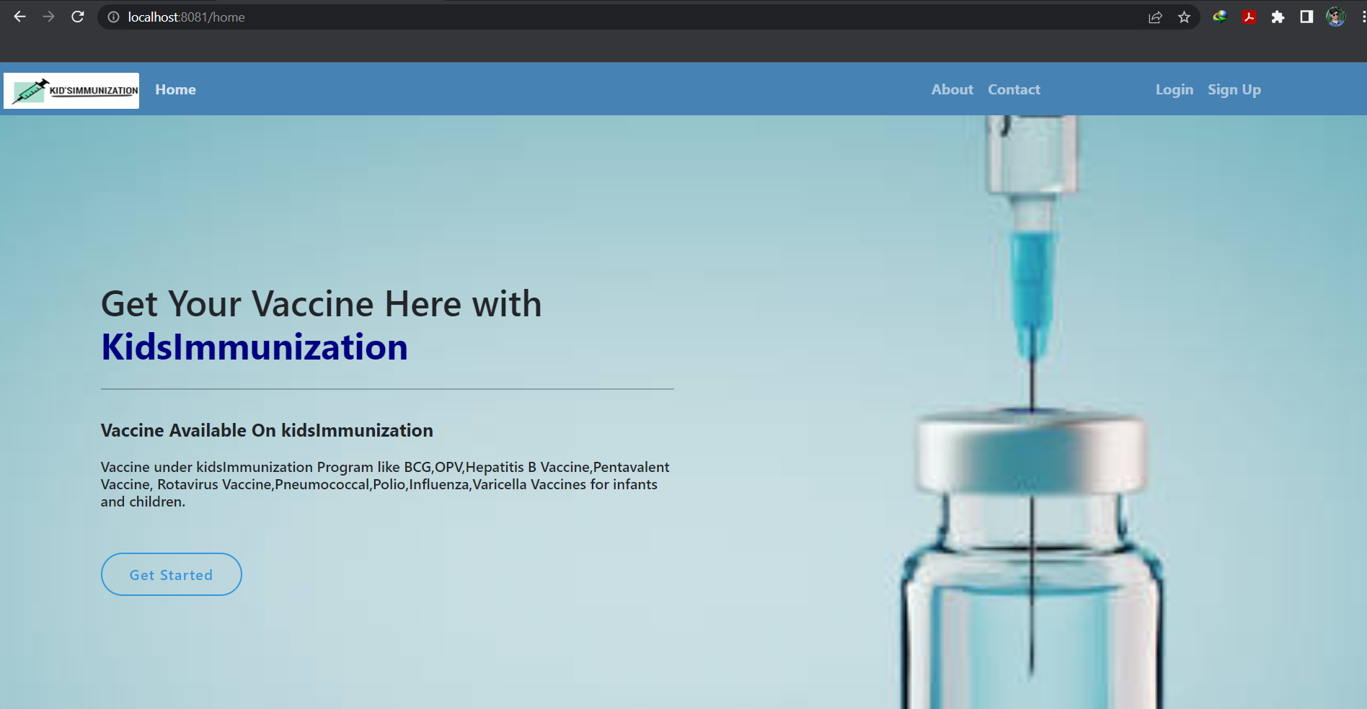
Home Page

Slide 17
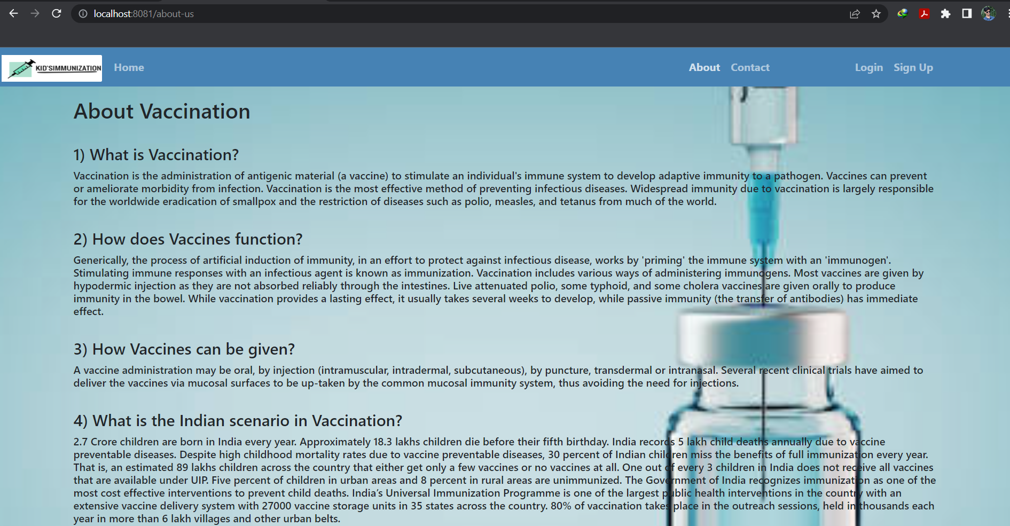
About Page

Slide 18
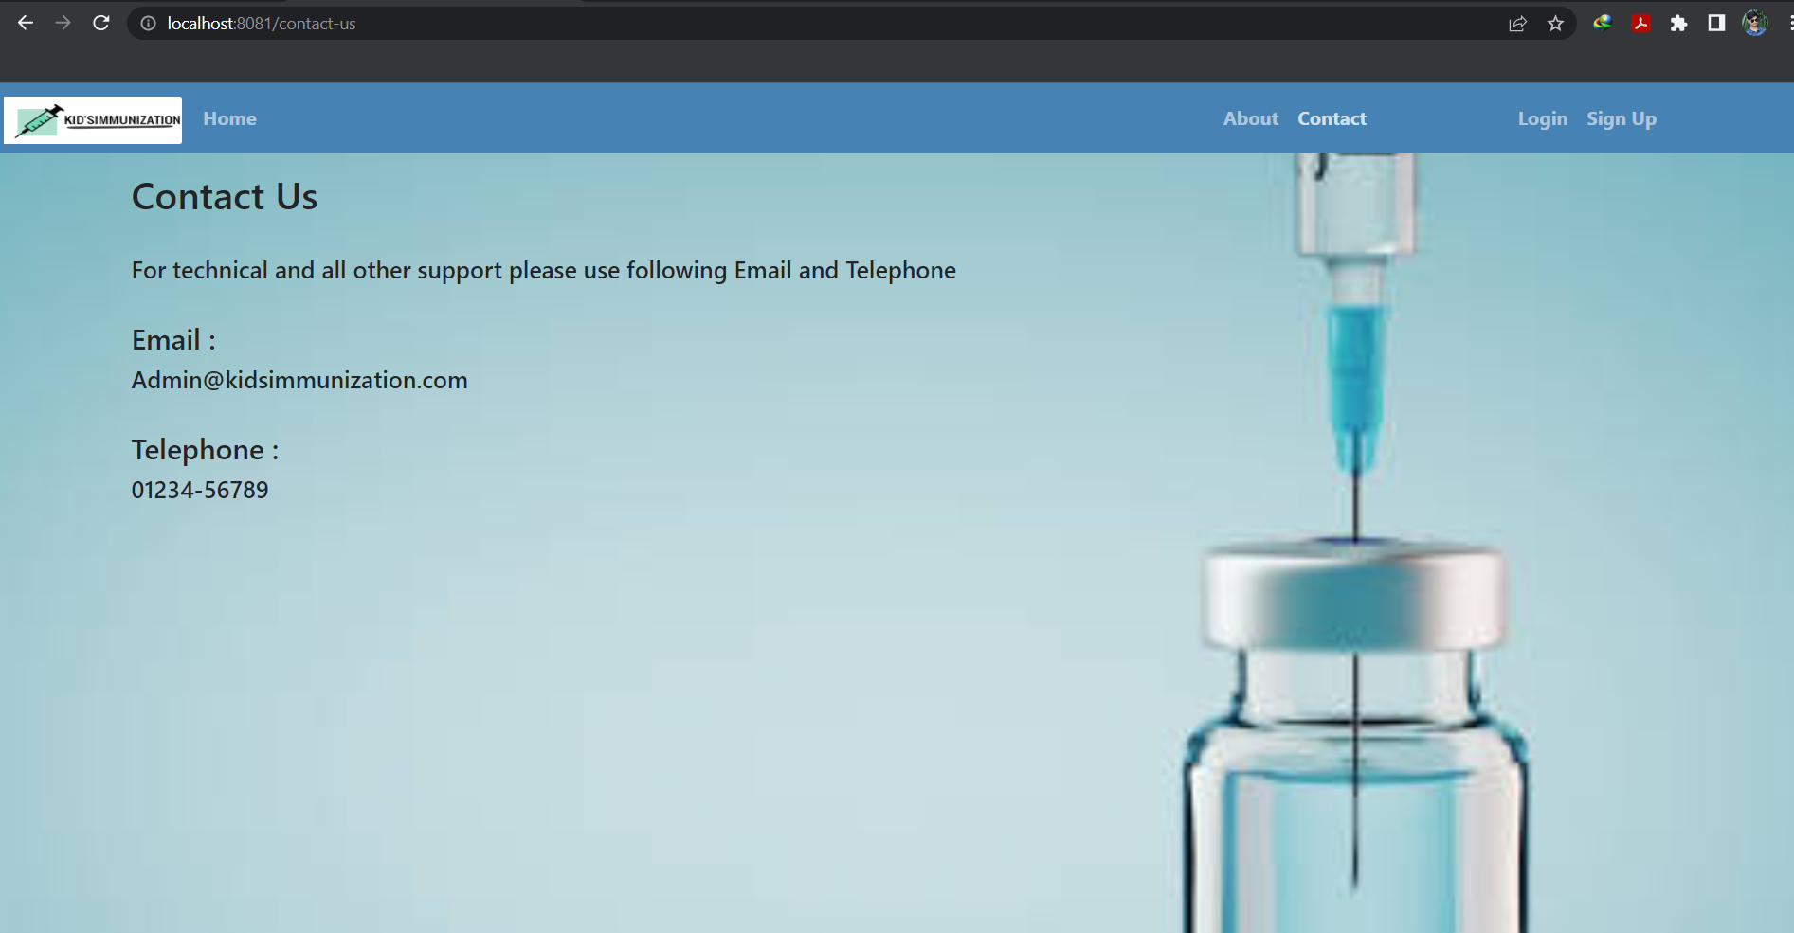
Contact Us Page

Slide 19
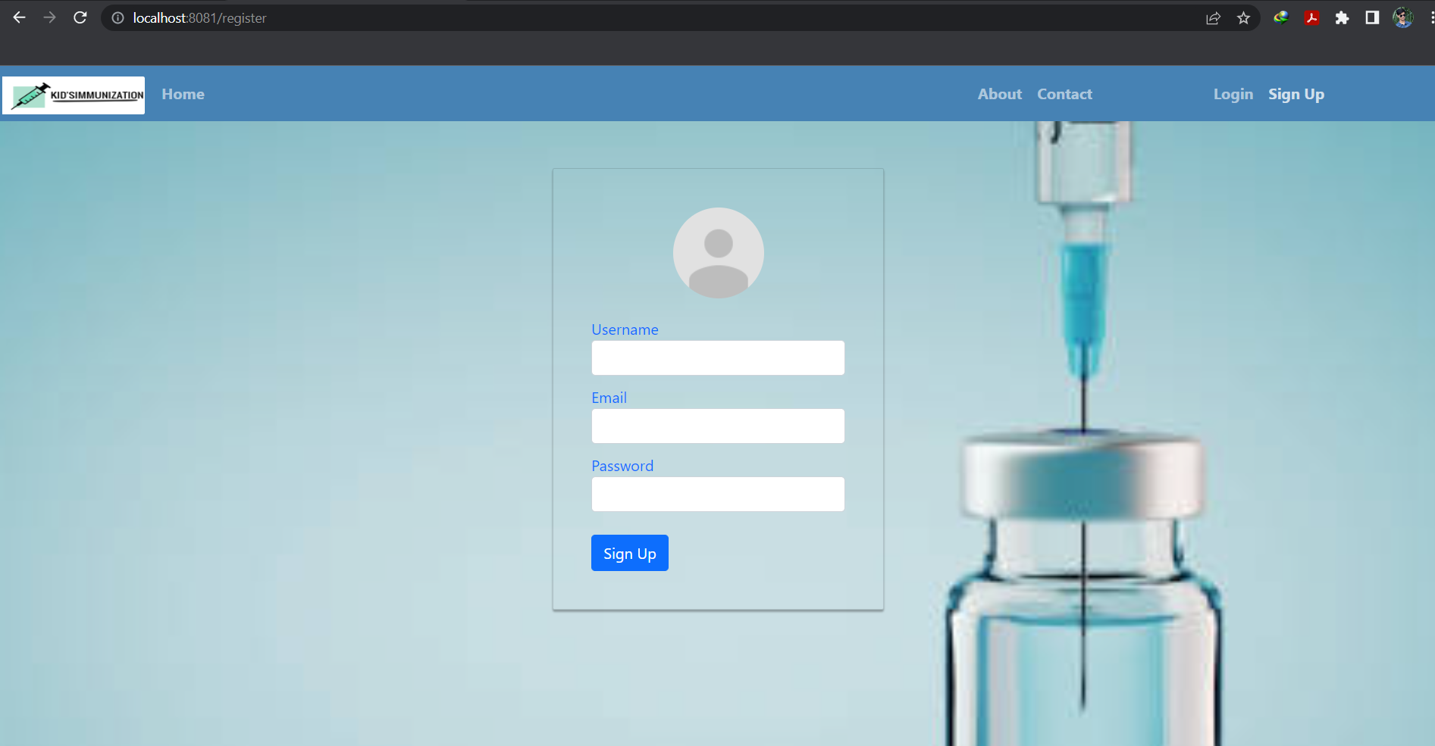
Sign Up Page

Slide 20
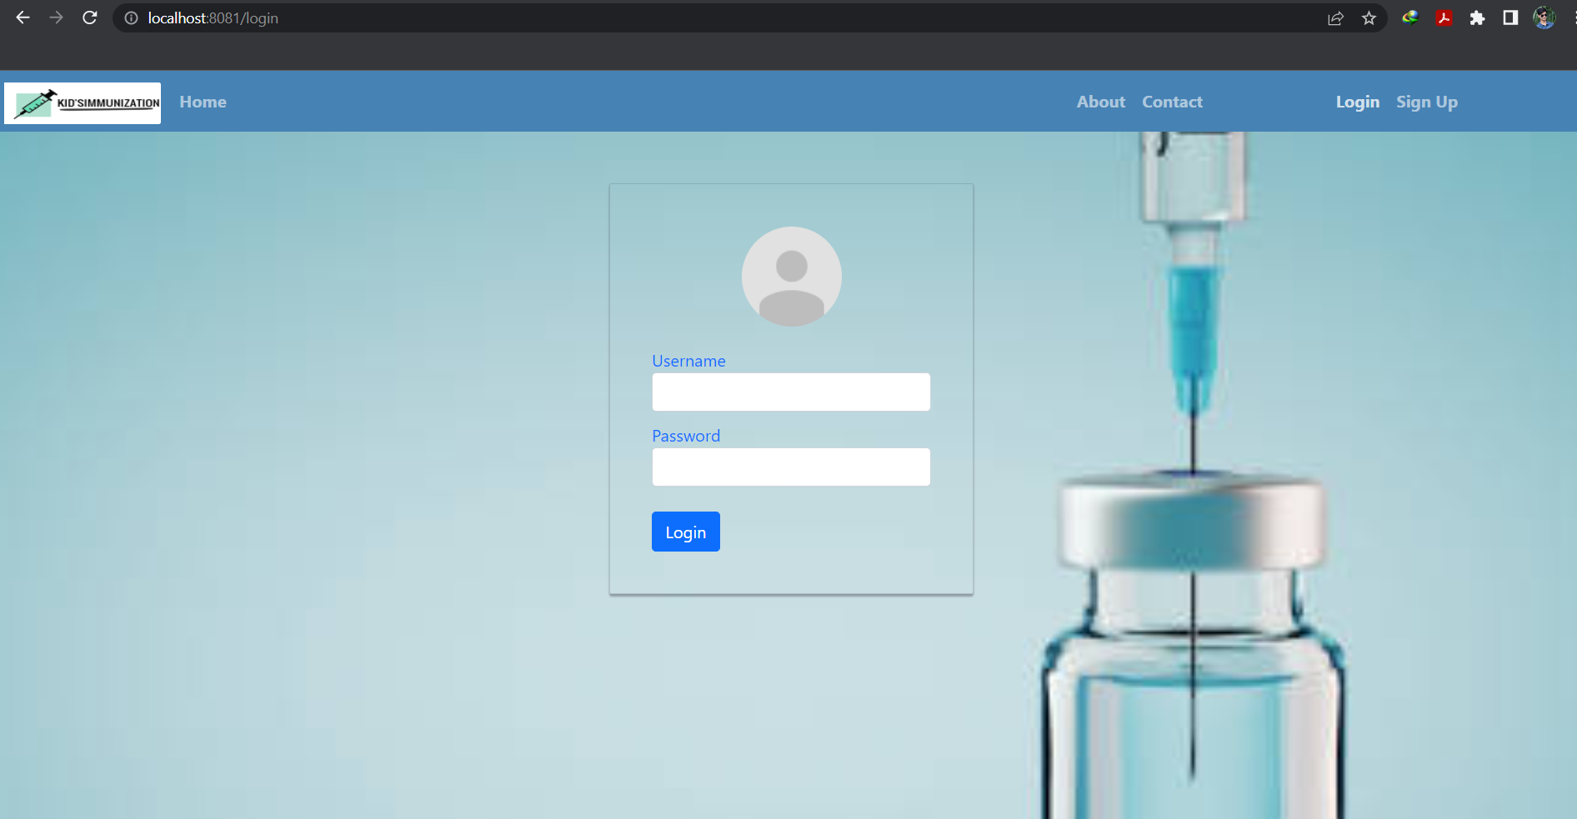
Login Page

Slide 21
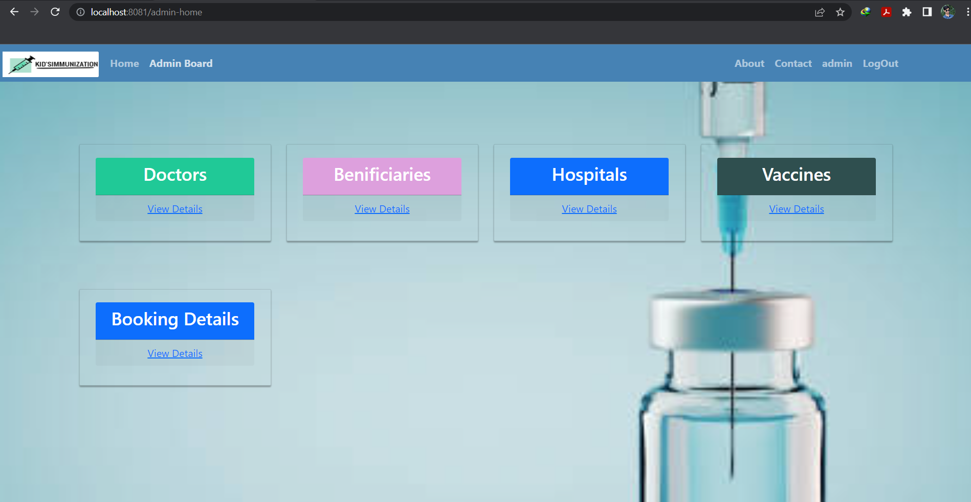
Admin Dashboard

Slide 22
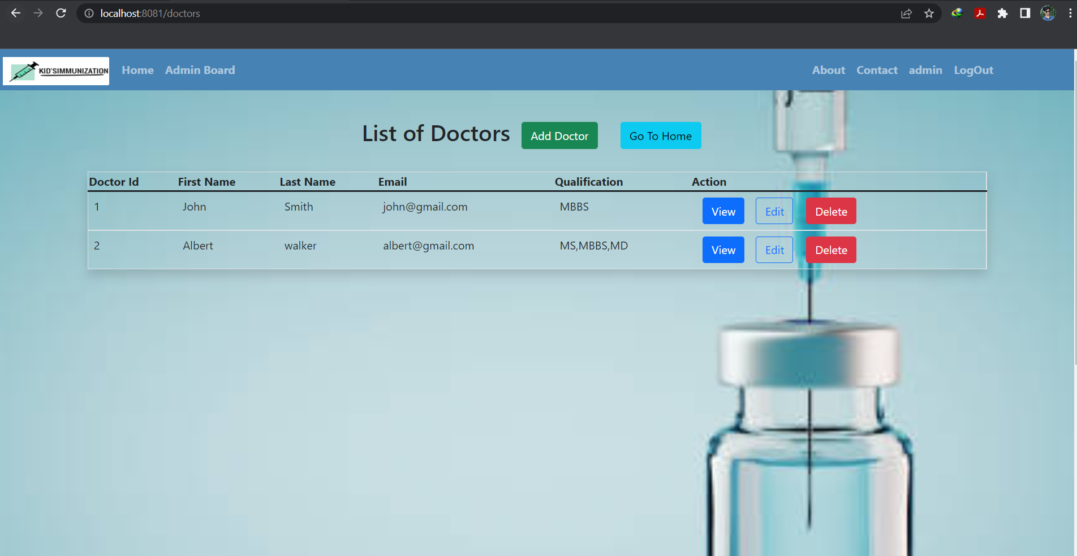
Doctor List

Slide 23
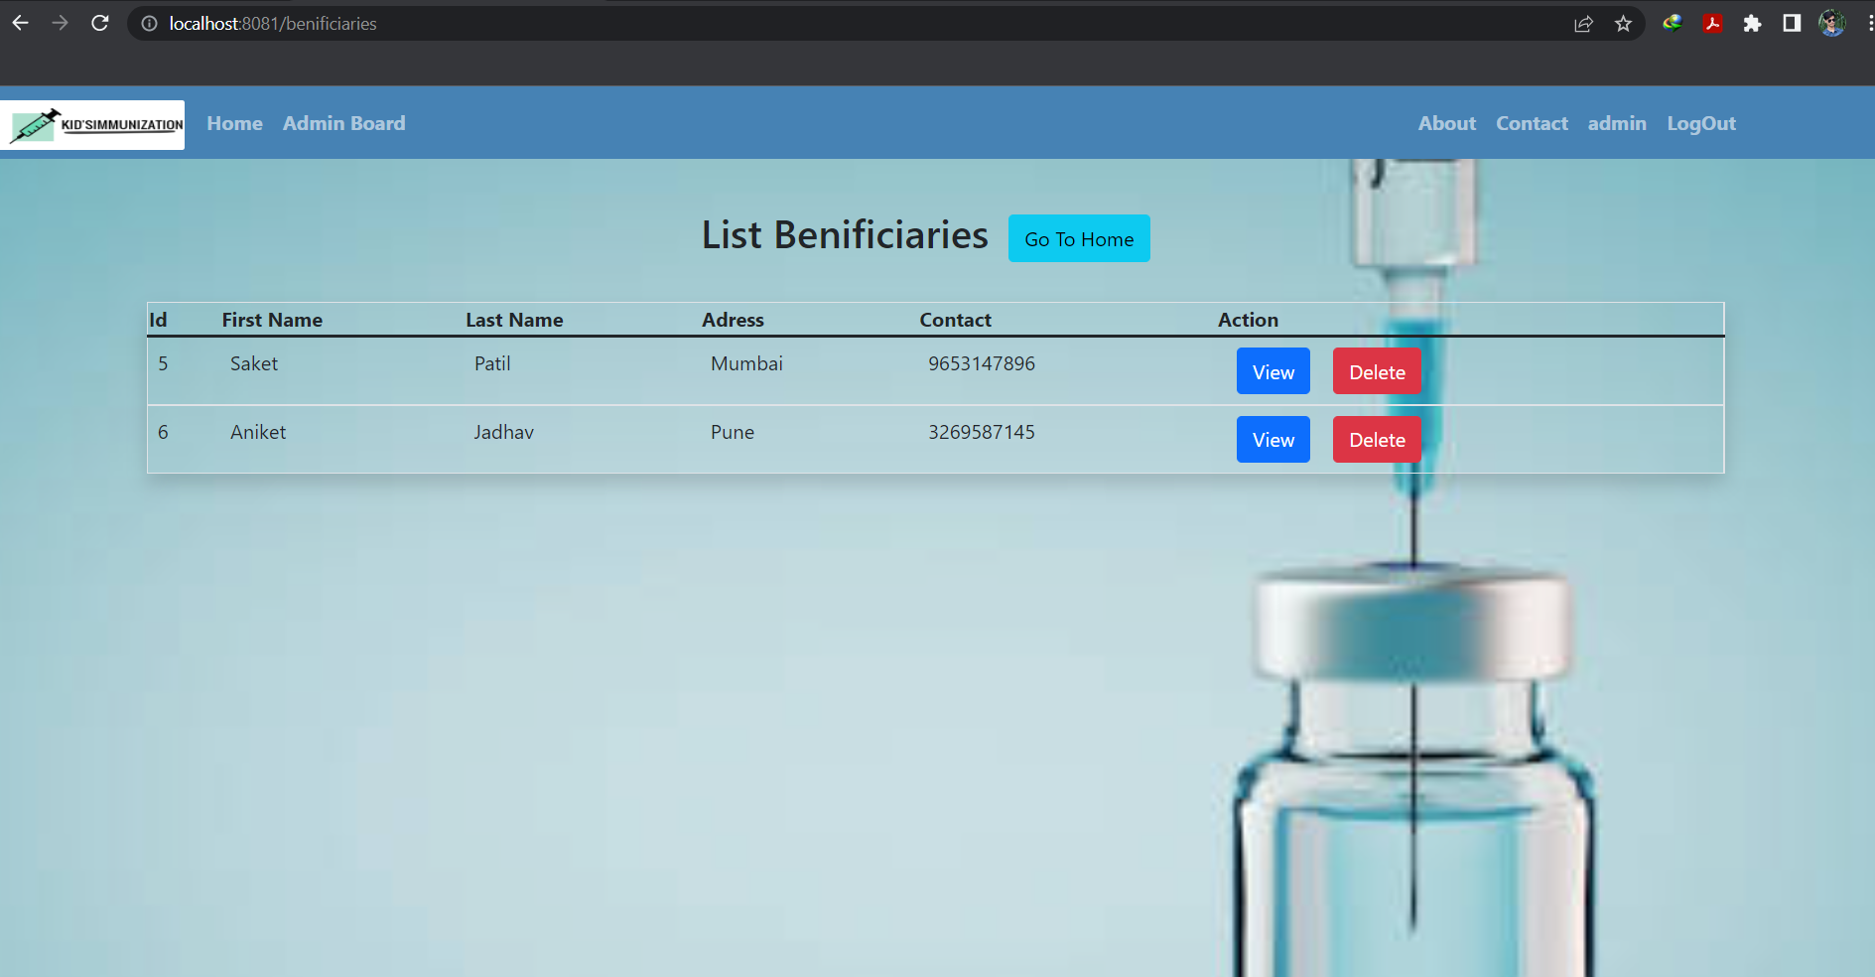
Beneficiaries List

Slide 24
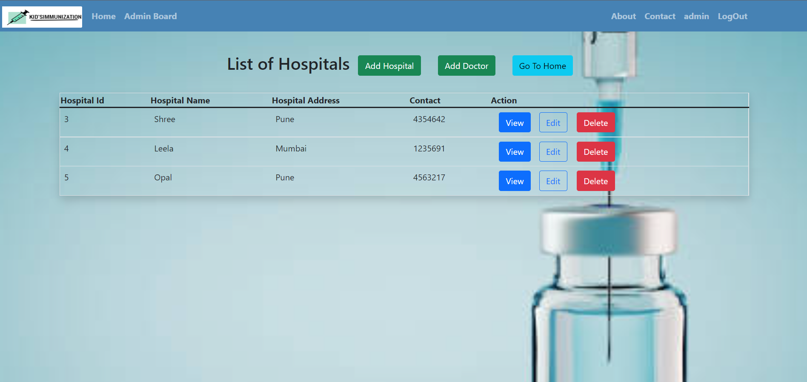
Hospital List

Slide 25
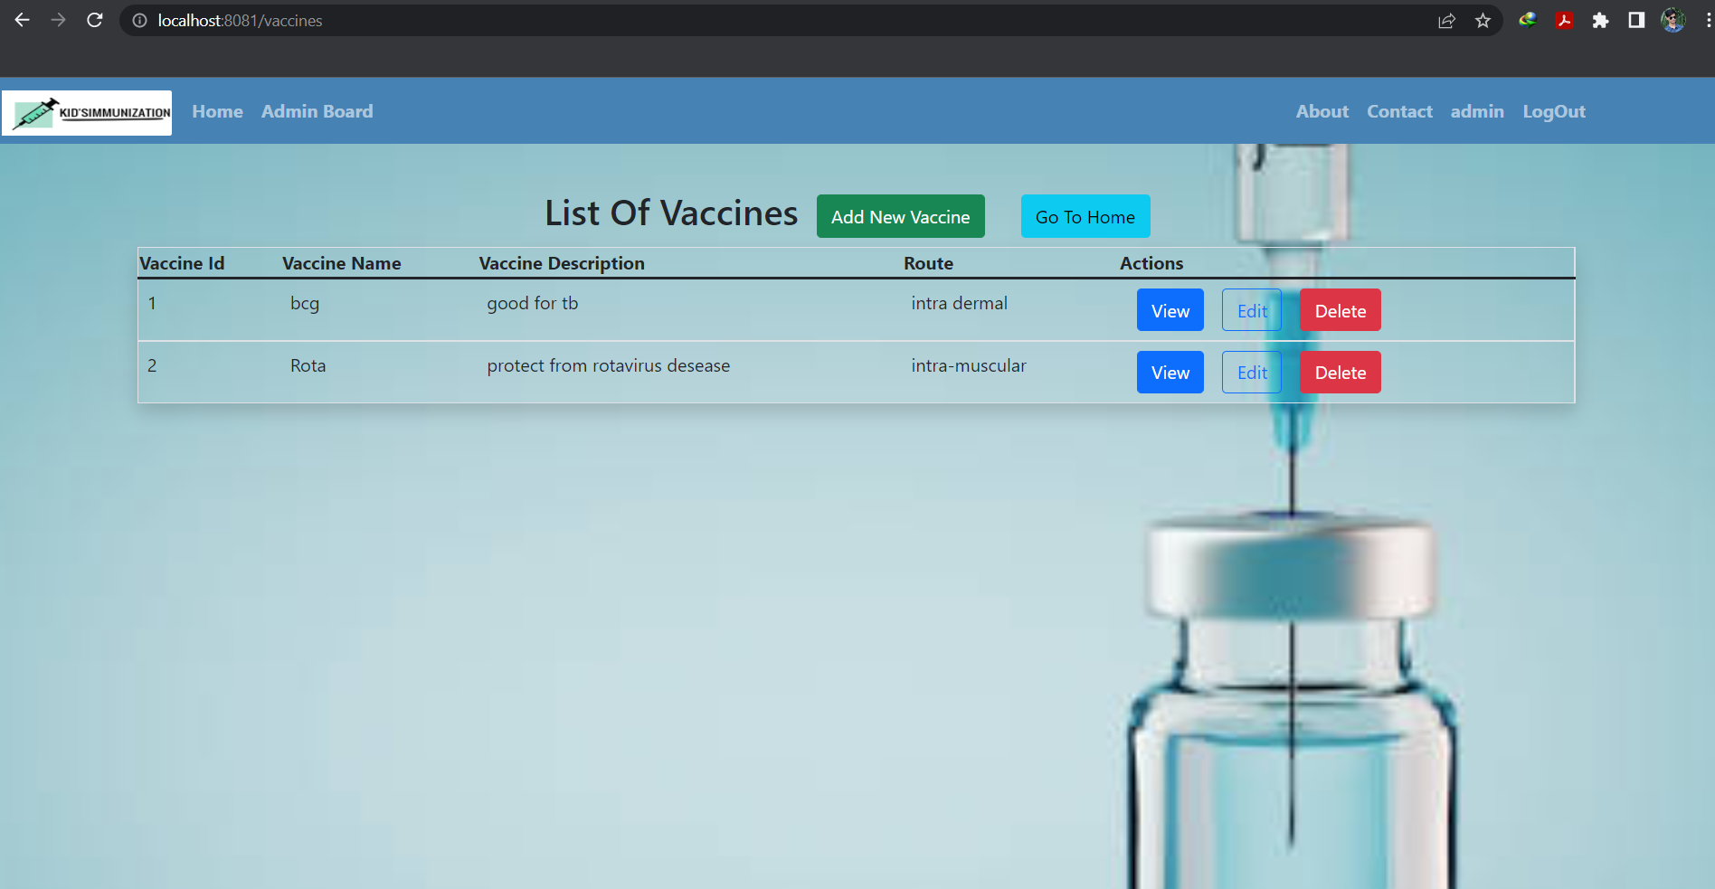
Vaccine List

Slide 26
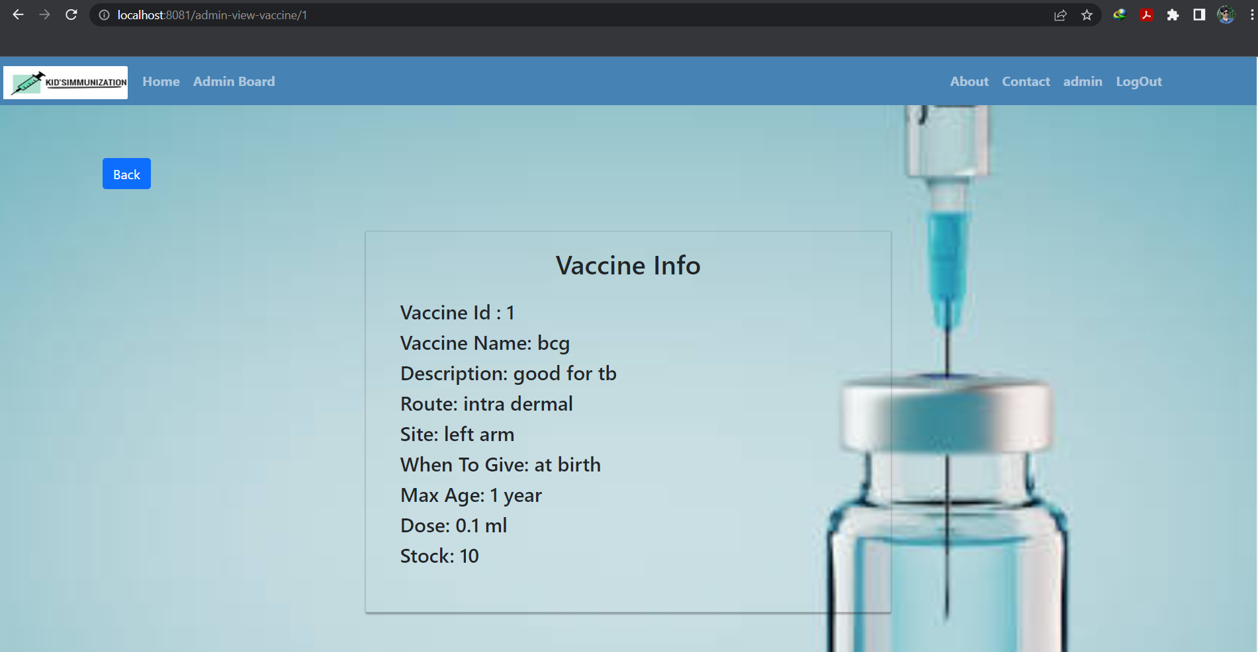
Vaccine Info

Slide 27
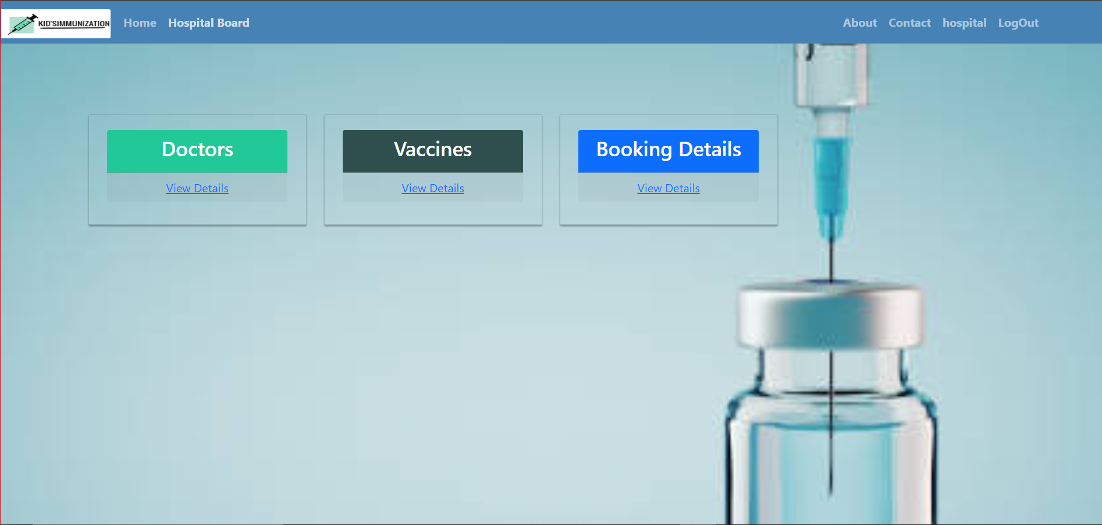
Hospital Dashboard

Slide 28
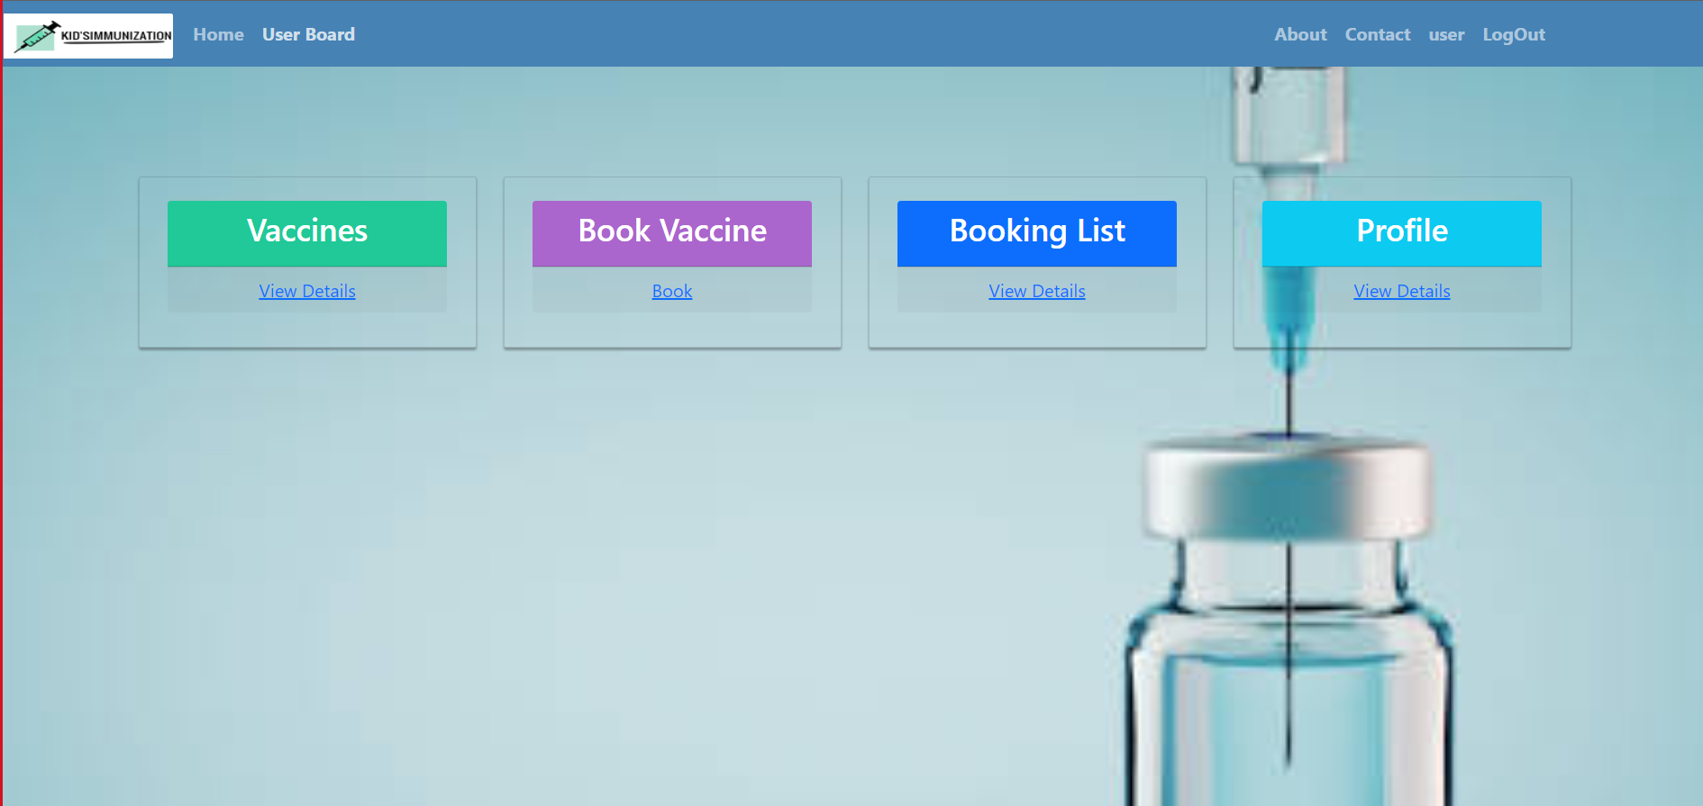
User Dashboard

Slide 29
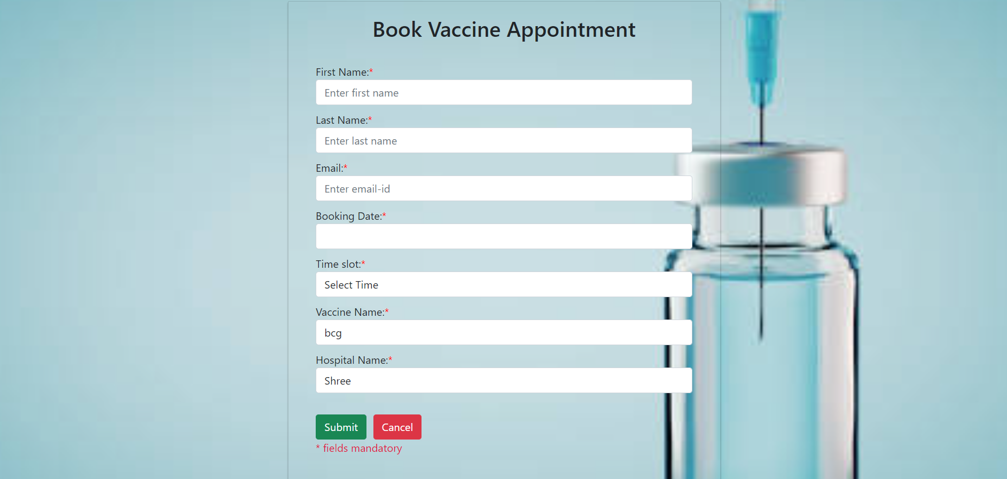
Book Vaccine Appointment

Slide 30
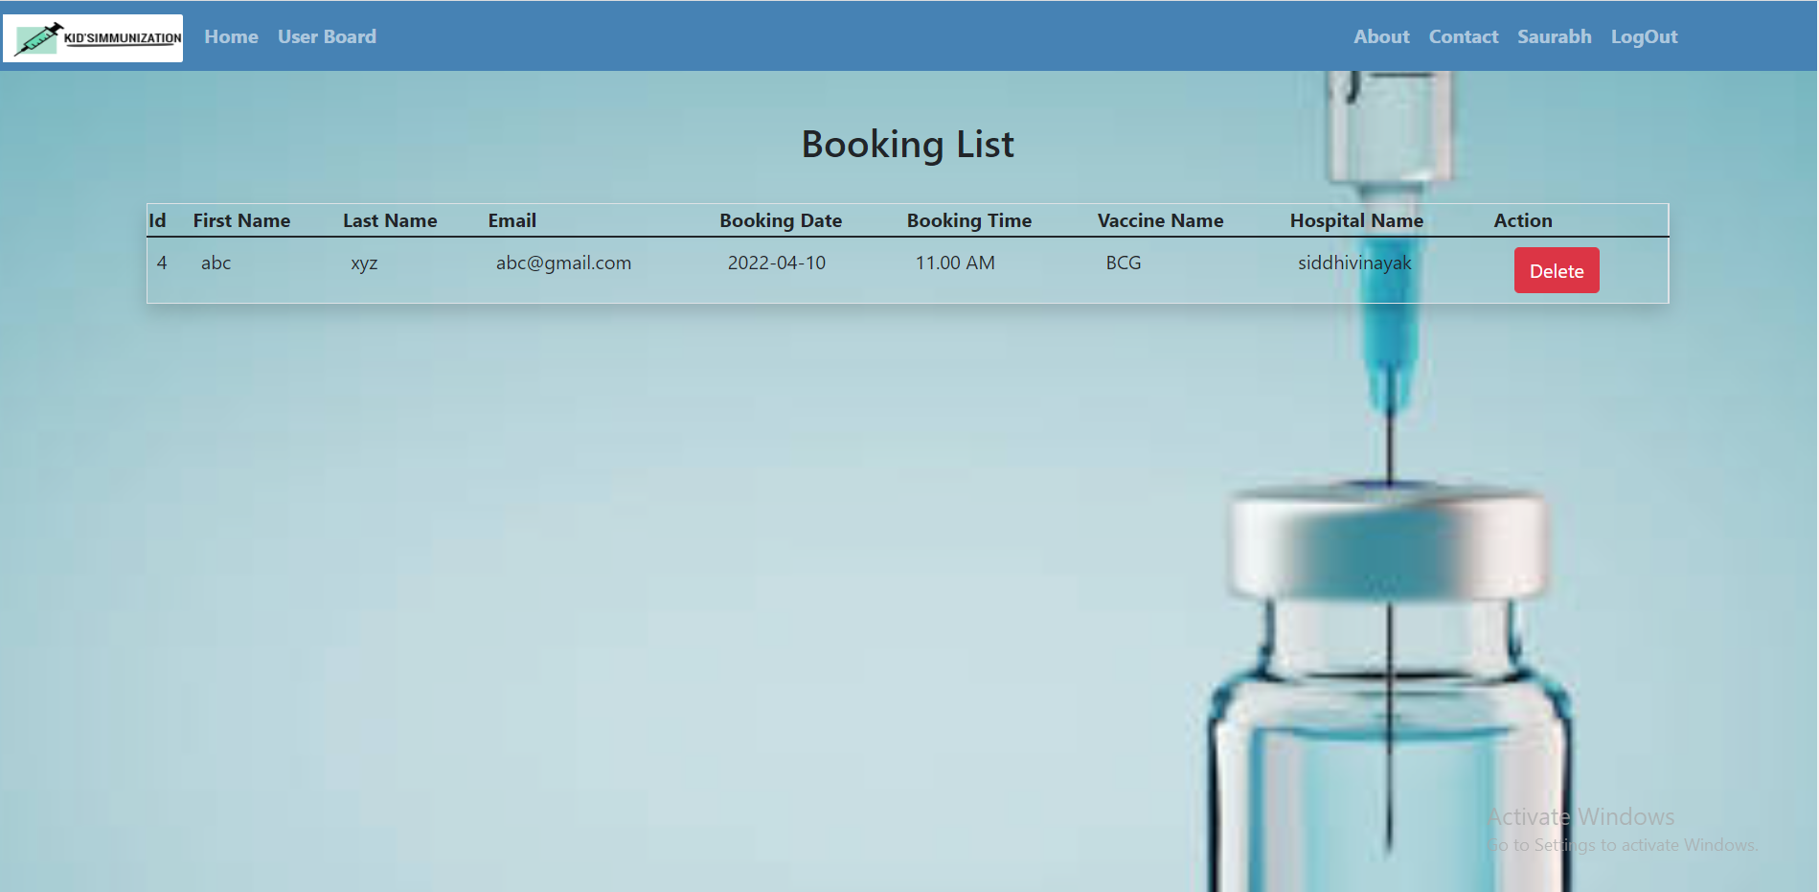
Booking List

Slide 31
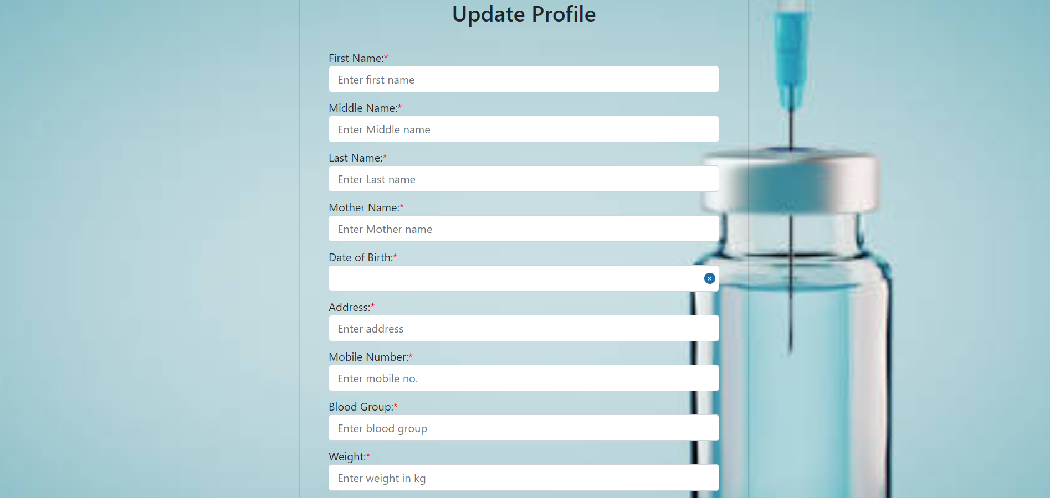
Update Profile for User

Slide 32
Conclusion
Child vaccination notifier system can be inevitable part of the lifecycle of the modern medical institution. It automates numerous operations and enables smooth interactions of the users. User can access services and functionalities from anywhere and anytime for their own comfort. Developing the child vaccination notifier system is a great opportunity to create the distinct, efficient and fast delivering healthcare model. This system covers the needs of the patients, staff and hospital authorities and simplifies their interactions. Many countries have already experienced its advantages and continue developing new child vaccination notifier system project modules.

Slide 33
Thank You

